Slide 1


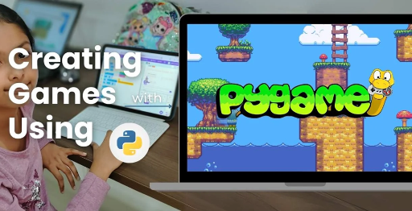
Session 4
Game Modes and Flow Control

Slide 2
Learning Objectives
Understand game inspiration, install Pygame-CE, navigate project structure
Detailed Objectives:
Understand the differences between Quick Game (score-based, 200 points) and Basic Game (destruction-based with power-ups).
Implement turn-based logic to alternate between players.
Enable switching between game modes from the main menu.

Slide 3
Practical Tasks
Understand game inspiration, install Pygame-CE, navigate project structure
Below is the list of Practical Tasks:
Update game_modes.py to define logic for Quick Game and Basic Game modes.
Implement a turn counter to switch between Player 1 and Player 2 after each bird launch.
Modify main.py and game_screens.py to add a mode selection menu (Quick Game, Basic Game).
Test mode switching by printing the current mode to the console.

Slide 4
Deliverables
Understand game inspiration, install Pygame-CE, navigate project structure
Session Deliverables:
game_modes.py with initial logic for both game modes.
A mode selection menu that switches between Quick and Basic modes.
Tips:
Work in pairs to brainstorm how turns should work.
Use comments in your code to explain each step.

Slide 5
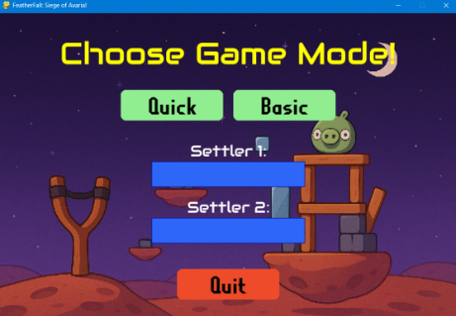
Game Modes and Flow Control in PyGame
Game Modes and Flow Control in PyGame
🎮 Focused on Quick Game vs Basic Game and mode-switching logic in OMOGAME : Siege of Avaria!

Slide 6
Game Modes & Flow Logic
✅ Game Modes & Flow Logic
“Understanding How Games Handle Player Turns and Rules” Introduce students to the concept of game modes and how flow control governs the player experience.
Introduce game modes in OMOGAME: Siege of Avaria!
Focus: How flow control shapes player experience.
Game inspired by Angry Birds, with two-player strategic battles.
Learn to implement Quick and Basic modes using Pygame-CE.
Explore turn management and mode selection for dynamic gameplay.

Slide 7
What Are Game Modes?
✅ What Are Game Modes?
Two types of gameplay:
⚡ Quick Game – First to 200 points
🧱 Basic Game – Full structure destruction with power-ups
Game behavior changes based on selected mode
📌 Located in game_modes.py
Two gameplay types in Siege of Avaria!:
⚡ Quick Game: First to 200 points by hitting blocks/aliens.
🧱 Basic Game: Destroy opponent’s structure with power-ups.
Game behavior adapts based on selected mode.
Managed in game_modes.py for modular logic.
Enhances player choice and game variety.
Key to replayability and strategic depth.

Slide 8
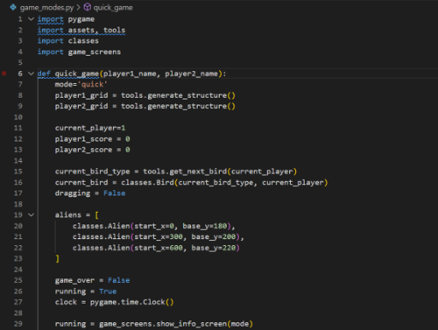
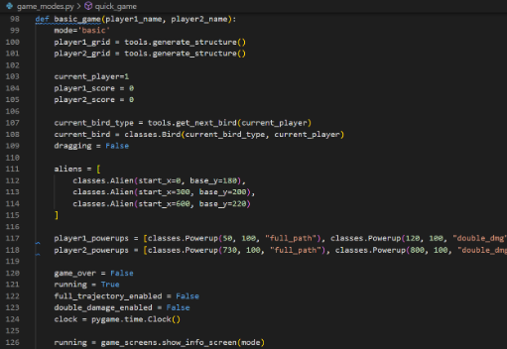
What Are Game Modes?
CODE SNIPPETs : GAME MODES

Slide 9
Why Game Modes Matter
✅ Why Game Modes Matter
Let players choose how they want to play
Increases replayability and difficulty options
Good practice for writing modular game logic
Allow players to choose preferred play style (fast or strategic).
Increase replayability with varied objectives and challenges.
Teach modular programming by separating game logic.
Support different win conditions (points vs. destruction).
Enable power-up integration in Basic Mode for added complexity.
Practice for real-world game design flexibility.

Slide 10
Code Files to Focus On
✅ Slide 4: Code Files to Focus On
File Name Purpose
main.py Game startup, mode selection, setup
game_modes.py Logic for Quick and Basic mode
game_screens.py Display screens and menus
🧩 Each file has a role in handling game flow
main.py: Initializes game, handles mode selection, and flow.
game_modes.py: Contains logic for Quick and Basic modes.
game_screens.py: Displays menus, mode selection, and game over screens.
tools.py: Supports turn rendering and game state updates.
Each file collaborates to manage game flow and transitions.
Critical for seamless mode switching and player interaction.

Slide 11
How Quick Game Works
✅ How Quick Game Works
Point-based scoring: hit blocks or aliens
Each bird earns points
Winner = First to 200 points
Simple turn switching logic after each bird
Objective: First player to reach 200 points wins.
Scoring: Points earned by hitting blocks or aliens.
Each bird launch contributes to player’s score.
Simple turn-switching after each bird’s trajectory ends.
Logic in game_modes.py tracks scores and win conditions.
Fast-paced, ideal for quick matches.

Slide 12
How Quick Game Works
CODE SNIPPETs : QUICK & BASIC GAMES

Slide 13
How Basic Game Works
✅ How Basic Game Works
Structures must be completely destroyed
Power-ups enabled (e.g., double damage, trajectory aid)
Turn switching + condition checking for structure state 📦 Requires additional logic checks in game_modes.py
Objective: Completely destroy opponent’s block structure.
Power-ups enabled (e.g., double damage, full trajectory view).
Turn-switching after each bird launch or rest.
game_modes.py checks structure health via classes.py Block.
Additional logic for power-up activation and effects.
Strategic mode with focus on planning and resource use.

Slide 14
Implementing Turn Switching
✅ Implementing Turn Switching
Turn Control Logic:
turn = 1 if turn == 2 else 2
🔄 Switch players after each bird completes its path 🎯 Can be displayed on-screen with a label like: "Now Playing: Player 1"
Turn control logic in game_modes.py:
turn = 1 if turn == 2 else 2
Switches players after bird completes its path or stops.
Display turn status: "Now Playing: Player 1" via tools.py.
Ensures fair alternation in both Quick and Basic modes.
Updates game state to track active player.
Critical for maintaining two-player gameplay flow.

Slide 15
Add a Mode Selection Menu
✅ Add a Mode Selection Menu
In game_screens.py → add:
Buttons: Quick Game / Basic Game
Store selection as global variable or mode flag
Print "Mode Selected: Quick" for testing
🧠 Use color-coded buttons and feedback sounds for UI enhancement
In game_screens.py:
Add buttons for Quick Game and Basic Game.
Store selection in global variable or mode flag.
Test with print: "Mode Selected: Quick".
Use assets.py to load button images from media/.
Enhance UI with color-coded buttons and feedback sounds.
Ensure main.py transitions to selected mode seamlessly.

Slide 16
Student Exercise Task – Build the Mode Manager
✅ Student Exercise Task – Build the Mode Manager
🛠️ Your practical deliverables:
Update game_modes.py with logic separation
Add turn counter to alternate players
Modify menu screen to select mode 💡 Bonus: Print score & mode at top of screen during gameplay
Deliverables:
Update game_modes.py to separate Quick/Basic logic.
Add turn counter for player alternation in game_modes.py.
Modify game_screens.py for mode selection menu.
💡Bonus: Display score and mode at top of screen via tools.py.
Save as: my_mode_manager.py.
Test functionality and submit for feedback.

Slide 17
Session Recap & Debugging Tips
✅ Session Recap & Debugging Tips
✅ You should now understand:
💡 Tip: Use print() often to debug game state and flow.
What you learned:
Differences between Quick and Basic modes.
Implementing turn alternation in game_modes.py.
Creating mode selection menus in game_screens.py.
Managing game flow across multiple modules.
Debugging tips:
Use print() to track game state (mode, turn, score).
Test mode transitions incrementally in main.py.
Reference: Pygame CE Documentation (https://pyga.me/docs/).

Slide 18

Exercise:
1. What is the primary objective of the Quick Mode in OMOGAME?
A) Collect all power-ups before the opponent
B) Launch birds without any destruction
C) Reach a score of 200 points
D) Complete the entire storyline
Answer: C) Reach a score of 200 points
2. Which file is considered the main entry point of the OMOGAME project? A) tools.py
B) main.py
C) assets.py
D) classes.py
Answer: B) main.py

Slide 19
Exercise..
3. What does the tools.py file mainly handle in the game?
A) Launching sound and animation
B) Player avatar selection
C) Collision detection and drawing functions
D) Managing game instructions
Answer: C) Collision detection and drawing functions
4. Which of the following is NOT listed as a unique feature of OMOGAME? A) Bird classes with special physics
B) Alien targets for bonus points
C) Multiplayer online matchmaking
D) Destructible block environments
Answer: C) Multiplayer online matchmaking

Slide 20
Exercise…
5. Why is organizing the OMOGAME project into files like classes.py, media/, and game_modes.py important?
A) It reduces the game’s memory usage
B) It helps reduce the number of bugs completely
C) It makes the project look colorful
D) It simplifies managing and updating different game parts
Answer: D) It simplifies managing and updating different game parts

Slide 21
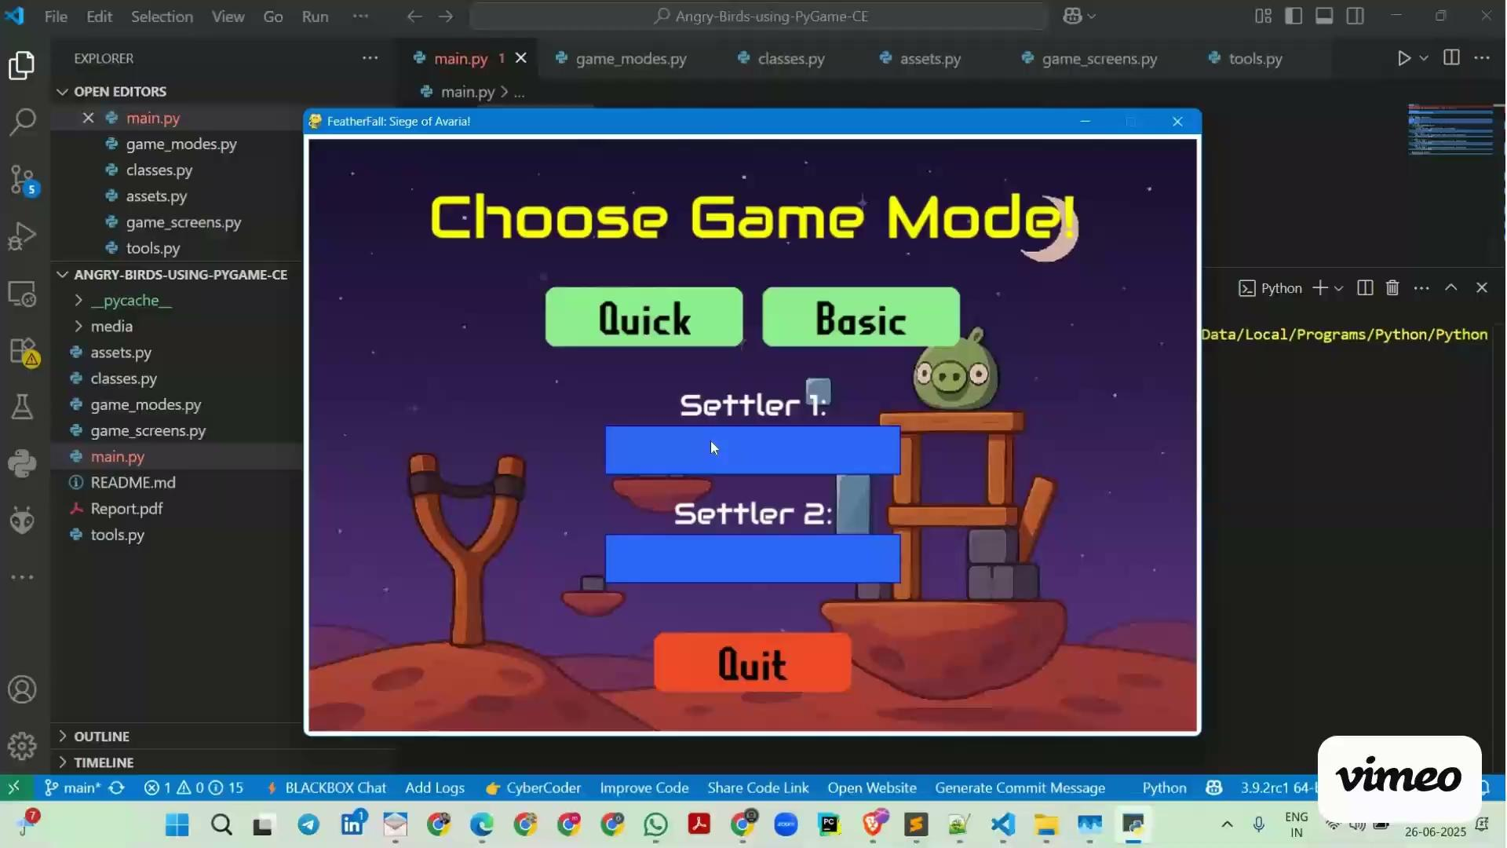
Session 4 VIDEO LINK
Game Modes and Flow Control

